Slide 1
Werber's Mercedes-Benz

Slide 2
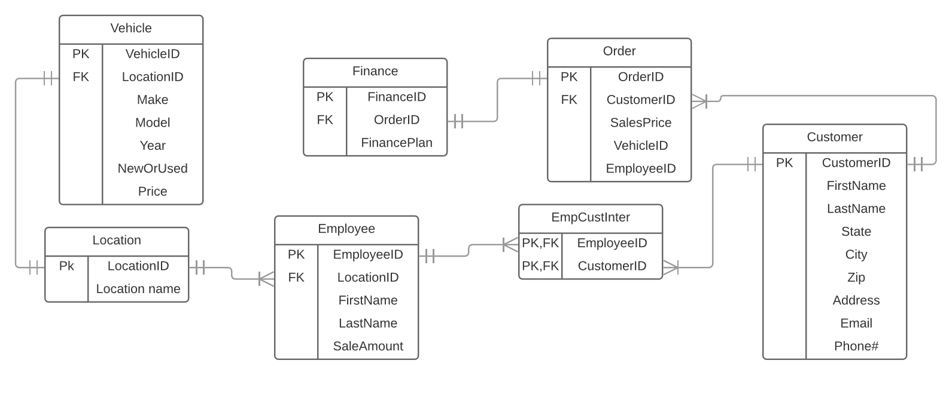
Brief Overview

Slide 3
Struggles
P3 (Obviously) and P5
Partner dropped

Slide 4
Successes
P4 and P6
Completing the project
Using SQL

Slide 5
Lessons Learned
Communication is key
Ask for help
Don’t put everything in at once

